Slide 1
Phase Transition in TSNE : Critical sample size for learning
Laura Bonde Holst S173953
Pranjal Garg s210242
Virgile Ulrik Blanchet-Møhl s163927

Slide 2
Who does what
____ Virgile
Introduction
Models
______ Laura
Experiment
Results
— Pranjal
Discussion
Future Work
Conclusion

Slide 3
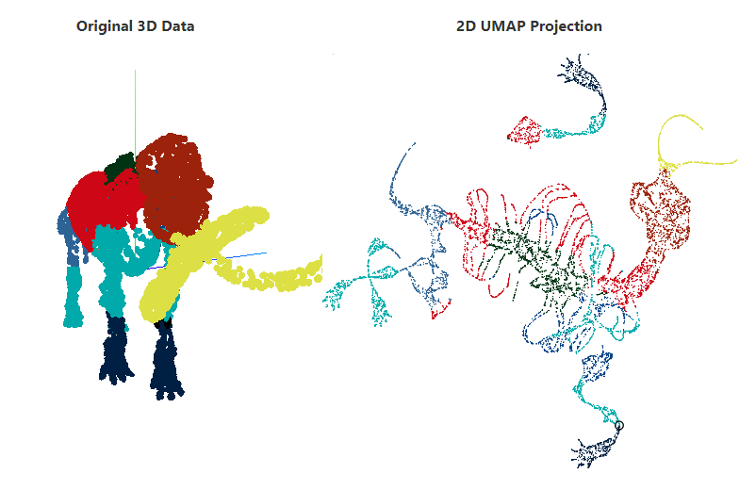
Introduction
Dimensionality reduction is an important tool for visualization of high-dimensional data
Multiple embedding algorithms have been proposed and see use
Our work studies the impact on learning of:
Missing data
Noise level
Class imbalance

Slide 4
DR Models
PCA | t-SNE | UMAP | Trimap
Linear dimensionality reduction based on finding direction that maximize variance | Stochastic neighbor embedding using t-distribution | Produces high-dimensional graph of data optimized into a low-dimensional representation | Constrained triplet neighbor embedding using added random neighbors
PCA performance is depending on noise and sample size | Focuses on local structure by weighing nearest neighbors increasingly | Decreasing likelihood of neighbor connection with distance to preserve local and global structure | Preserves local structure with constrained neighbors

Slide 5
PCA

Slide 6
t-SNE

Slide 7
UMAP

Slide 8
TriMap

Slide 9
Experiment
DR Techniques | Datasets | Noise levels | Class distribution | Sample size
PCA t-SNE UMAP TriMap | MNIST (8x8) (0+1) Fashion-MNIST (28x28) (Trousers + sneakers) | μ = 0, σ² = 0 μ = 0, σ² = 0.2 μ = 0, σ² = 0.5 μ = 0, σ² = 0.7 μ = 0, σ² = 1 | Stratified at 50/50 Stratified at 25/75 | 4 datapoints . . . 90 datapoints

Slide 10
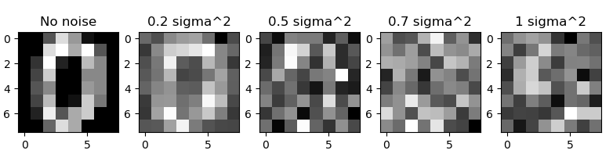
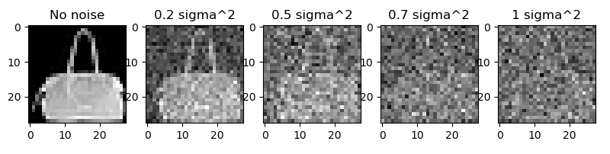
Experiment: Noise levels

Slide 11
Experiment
DR Techniques | Datasets | Noise levels | Class distribution | Sample size
PCA t-SNE UMAP TriMap | MNIST (8x8) Fashion-MNIST (28x28) | μ = 0, σ² = 0 μ = 0, σ² = 0.2 μ = 0, σ² = 0.5 μ = 0, σ² = 0.7 μ = 0, σ² = 1 | Stratified at 50/50 Stratified at 25/75 | 4 datapoints . . . 90 datapoints

Slide 12

Experiment: Accuracy
K-Means clustering
Calculate accuracy

Slide 13
Experiment: Experiment flow

Slide 14
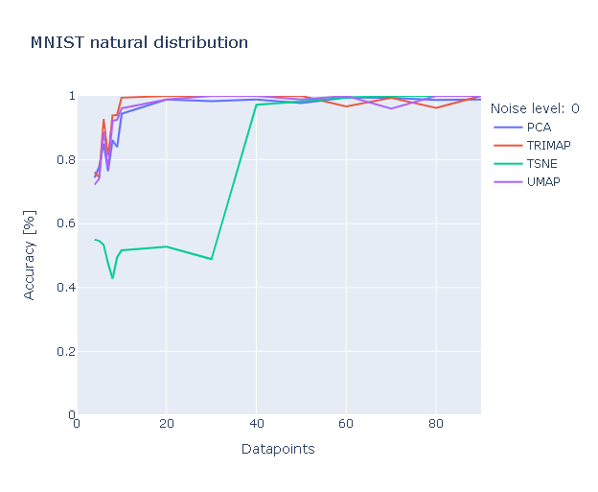
Results:
Dataset | Noise levels | Class distribution
MNIST | σ²=0 | 50/50

Slide 15
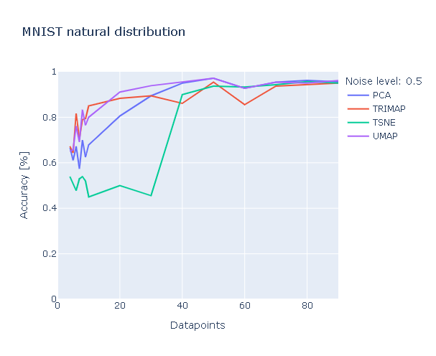
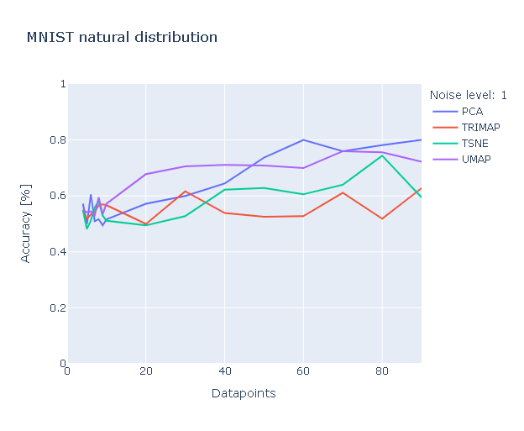
Results:
Dataset | Noise levels | Class distribution
MNIST | Varying | 50/50

Slide 16
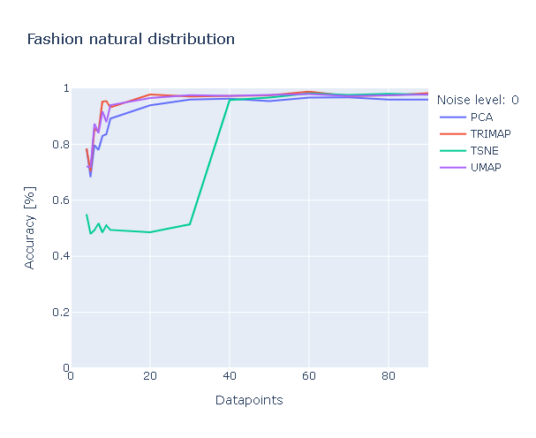
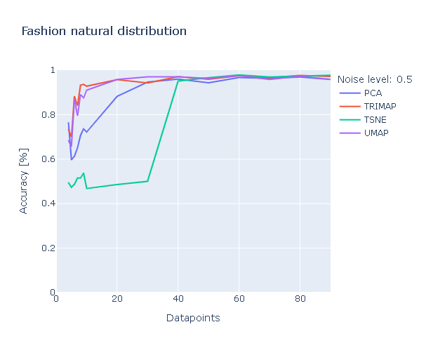
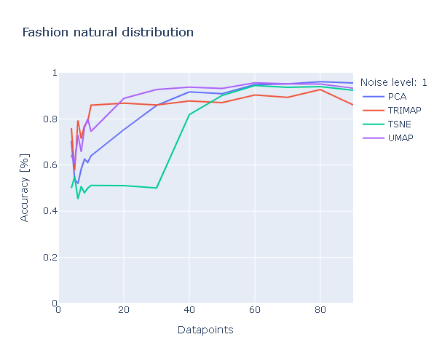
Results:
Dataset | Noise levels | Class distribution
Fashion-MNIST | Varying | 50/50

Slide 17
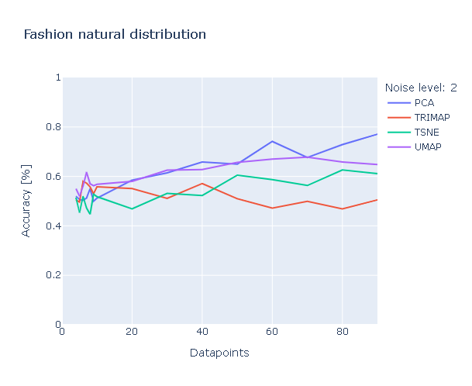
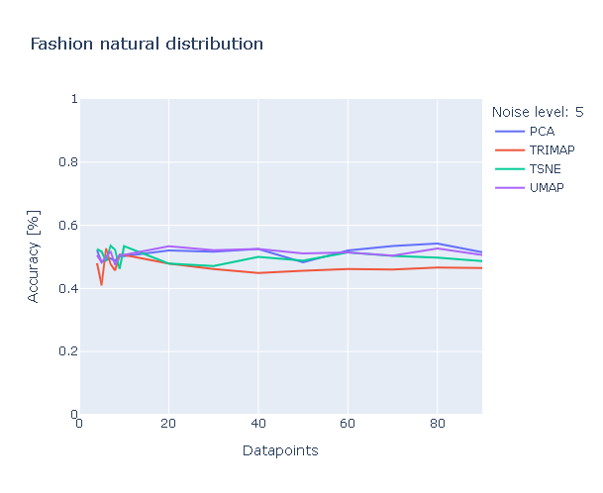
Results:
Dataset | Noise levels | Class distribution
Fashion-MNIST | Varying (high) | 50/50

Slide 18
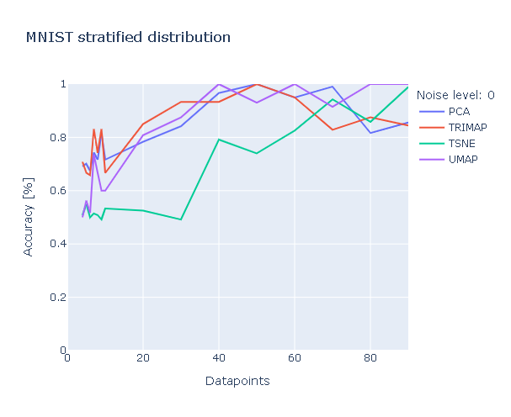
Results:
Dataset | Noise levels | Class distribution
MNIST | σ²=0 | Varying

Slide 19
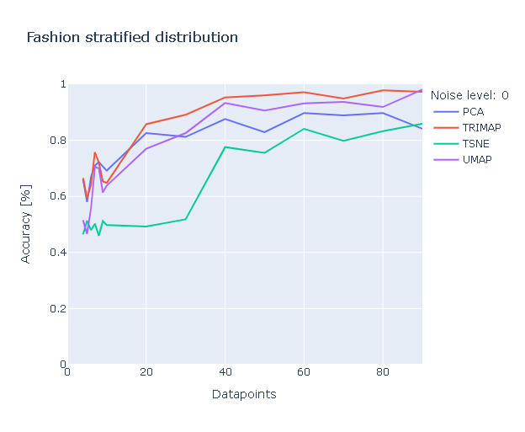
Results:
Dataset | Noise levels | Class distribution
Fashion-MNIST | σ²=0 | Varying

Slide 20
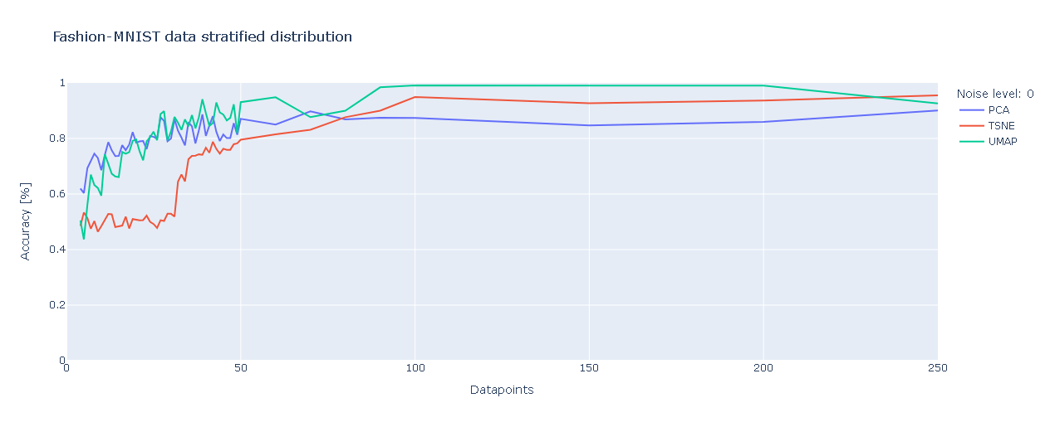
Results:
Dataset | Noise levels | Class distribution
Fashion-MNIST | σ²=0 | 25/75
OBS
Note colors!

Slide 21
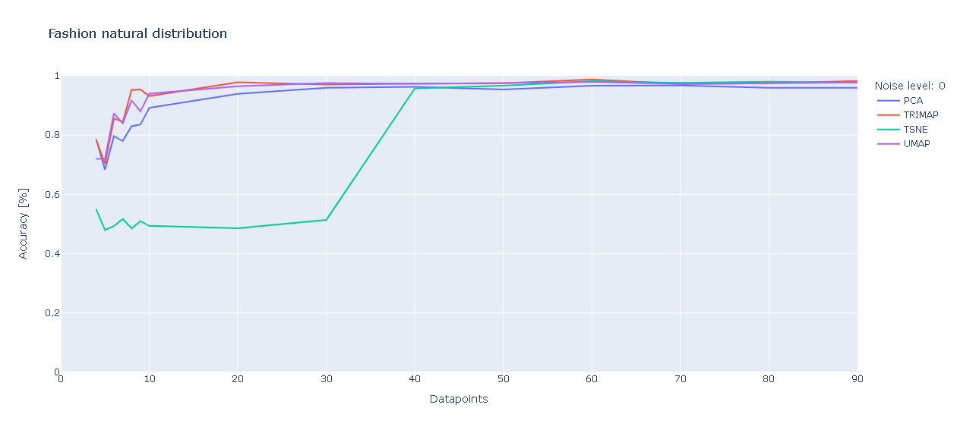
Discussion : Phase transition in t-SNE
Critical Threshold over 30 points for learning in t-SNE.
Others show slight phase transition between 4 and 10.
Notes:
. Otherwise it is seemingly a matter of merely tens of data points that makes the difference in performance in learning by t-SNE.

Slide 22
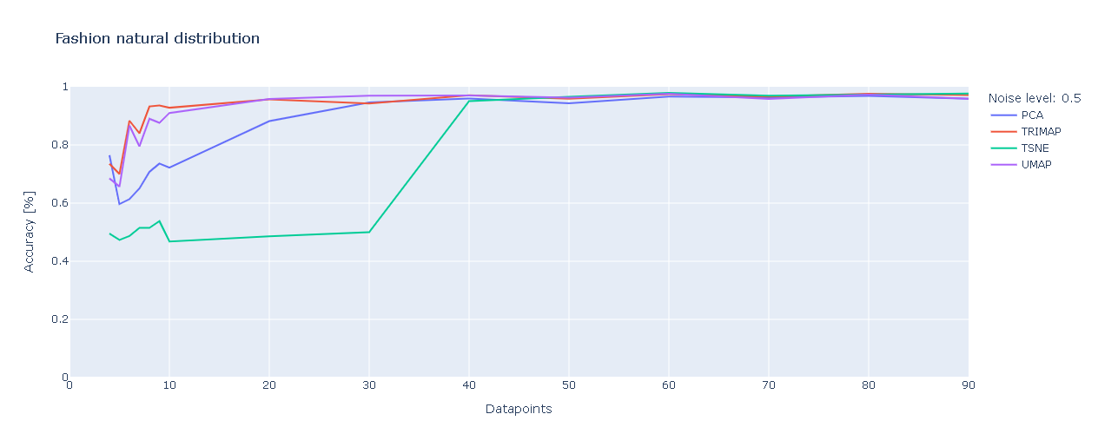
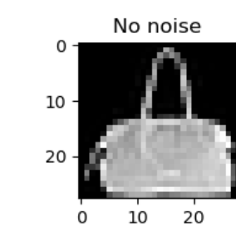
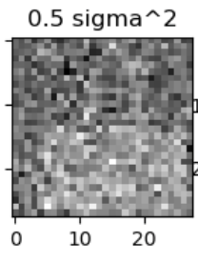
Discussion : Effects of noise
t-SNE’s Magic number 40!
PCA shows gradual learning till 40
UMAP , Trimap still at 10.
Notes:
. Otherwise it is seemingly a matter of merely tens of data points that makes the difference in performance in learning by t-SNE.

Slide 23
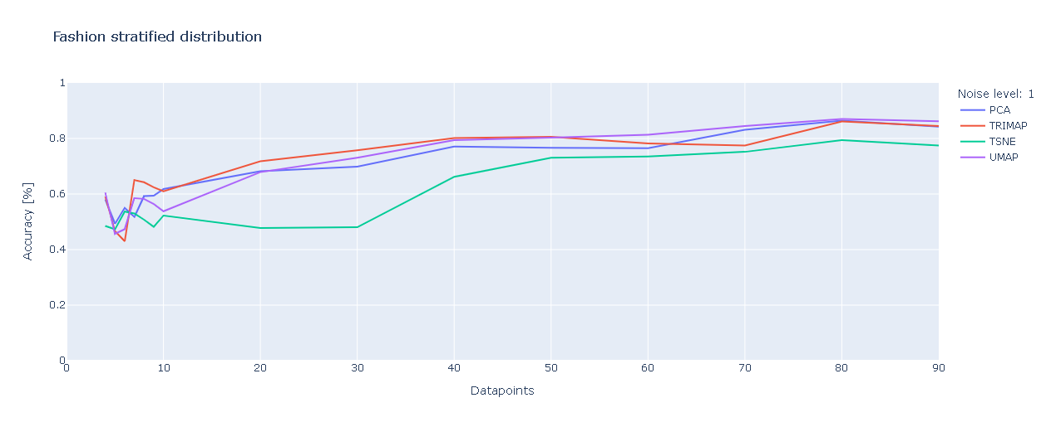
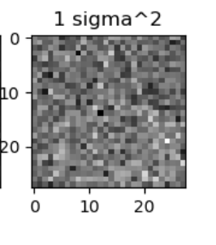
Discussion : More noise
Others showing steeper learning till 40 points too
Slope of learning curve reduced
Decreased accuracy
Notes:
. Otherwise it is seemingly a matter of merely tens of data points that makes the difference in performance in learning by t-SNE.

Slide 24
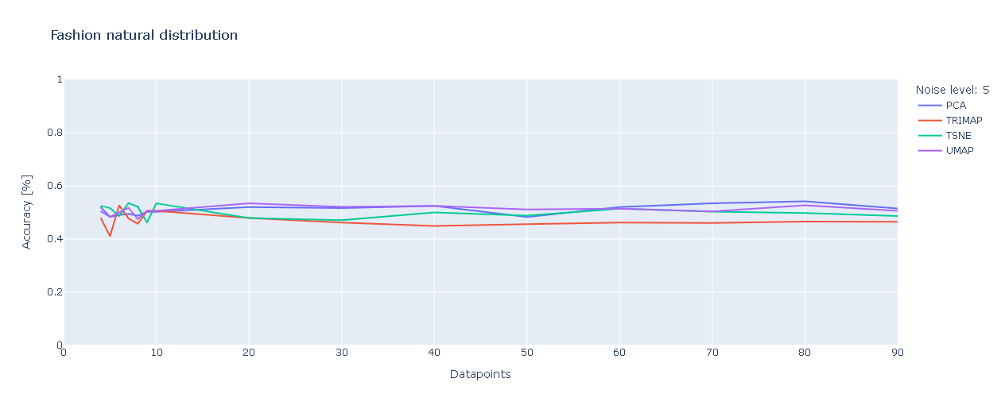
Discussion : Very noisy data
All signal lost
Notes:
. Otherwise it is seemingly a matter of merely tens of data points that makes the difference in performance in learning by t-SNE.

Slide 25
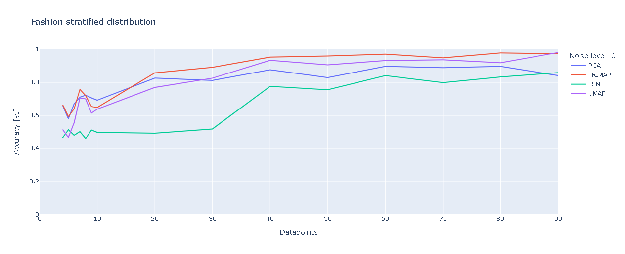
Discussion : Imbalanced classes
More consistent learning for other techniques till 40?
Similar effects to noise
More profound effect on accuracy

Slide 26
Discussion : Class imbalance with noise
Higher learning rates till 40 for others and phase transition after 30 in t-SNE

Slide 27
Discussion : Dimensionality effects
Higher dimensional dataset more robust to noise but do degrade with even higher noise levels
Need Signal to Noise ratio measure to better understand effects of dimensions.

Slide 28
Discussion Summary
In our experiments, we consistently see a phase transition in TSNE between 30 and 40 data points.
Only with strong noise signals the phase transition disappears which is due to the original signal being nullified
The other models perform decently from beginning with step wise improvement in their learnings.
With stratification, you do see slight phase transitions in the other models which could potentially indicate a need of minimum data points for their learnings as well.
Notes:
. Otherwise it is seemingly a matter of merely tens of data points that makes the difference in performance in learning by t-SNE.

Slide 29
Future Work
Simulated data with extremely high and low dimensions.
Signal-to-noise ratio.
Test on other DR techniques like LargeVis, Kernel PCA , Laplacian Eigenfolds. and PAC-MAP
Missing data.
Notes:
And see if they show a phase transition as well or its just t-SNE

Slide 30
Conclusions
A critical number of points are needed for learning to start from t-SNE.
No other DR methods that we tested showed such a phase transition.
Learning speed is affected by noise in the signal and class imbalance.
A constant phase transition around 30-40 for t-SNE in our experiments.
Future work needed to reaffirm experiment results without using k-means.
Notes:
We observe a phase which was between 30 and 40 data points in our simulations for t-SNE , regardless of noise and class imbalance.

Slide 31
Appendix

Slide 32
Appendix: Noise levels

Slide 33
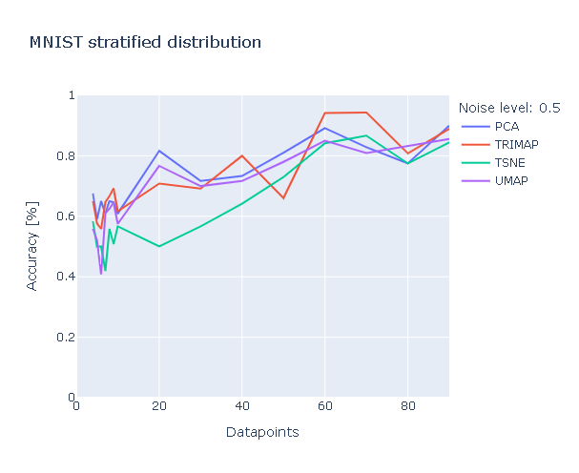
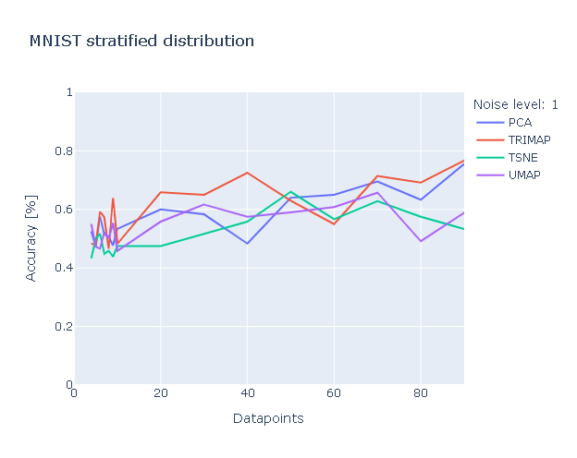
Appendix
Dataset | Noise levels | Class distribution
MNIST | Varying | 25/75

Slide 34
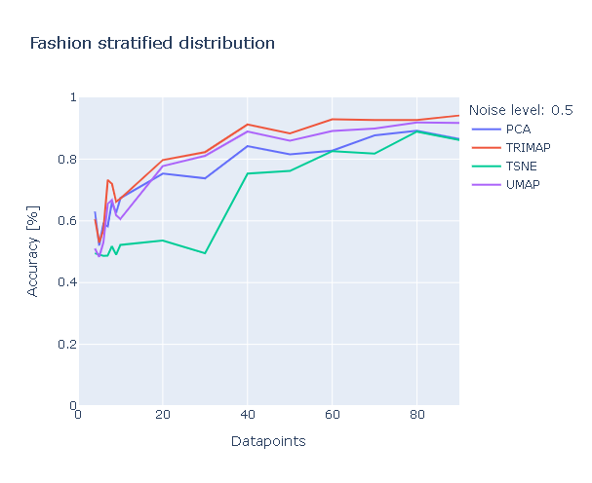
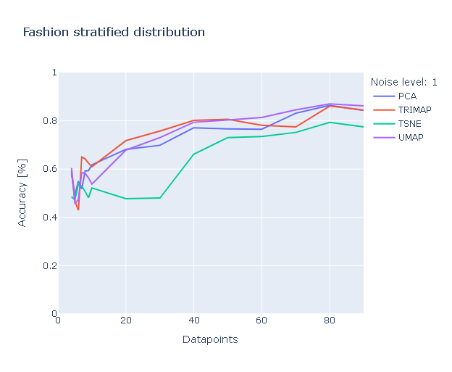
Appendix
Dataset | Noise levels | Class distribution
Fashion-MNIST | Varying | 25/75

